Slide 1
Predicting Eligibility for NSAP: using Machine Learning
CAPSTONE PROJECT
Presented By:
Pratiksha Kishorrao Parise
MIT College of Railway Engineering & Research Barshi,
Solapur , Maharashtra
Branch: Computer Science and Engineering

Slide 2
OUTLINE
Problem Statement
Proposed System/Solution
System Development Approach
Algorithm & Deployment
Result Conclusion
Future Scope
References

Slide 3
Problem Statement
Traditional manual processes for NSAP eligibility are inefficient and error-prone, causing:
Significant delays in aid distribution to vulnerable citizens.
Increased potential for human error and misallocations.
Lack of transparency and accountability.
High administrative burden on government resources.
This creates a critical need for a modernized, accurate, and efficient system to ensure timely and equitable distribution of vital social assistance.

Slide 4
Proposed Solution
The proposed system aims to automate the process of determining eligibility for the National Social Assistance Programme (NSAP) using a machine learning model.
Here's a brief summary of the key steps:
Data Collection & Preprocessing: The system will gather historical demographic and socio-economic data from sources like the AI Kosh dataset. This data will then be cleaned and preprocessed to prepare it for analysis.
Machine Learning: An automated machine learning model, powered by IBM Watsonx.ai's AutoAI, will be trained to predict the most suitable NSAP scheme for an applicant. This component handles algorithm selection, feature engineering, and hyperparameter tuning automatically.
Deployment: The trained model will be deployed as a RESTful API on IBM Cloud. A user-friendly interface will be developed to allow for real-time predictions.
Evaluation: The model's performance will be evaluated using metrics such as Accuracy, Precision, Recall, and F1-Score to ensure its reliability and accuracy.
Result: The final output is a predicted NSAP scheme and a confidence score for each applicant, providing an efficient and data-driven recommendation for scheme allocation.

Slide 5
System Approach
Data Inputs: Historical NSAP applicant data (demographic and socio-economic).
Cloud Platform: A reliable cloud environment like IBM Cloud.
Machine Learning Capabilities: Tools for automated data preprocessing, model training, evaluation, and deployment (specifically mentions IBM Watsonx.ai and AutoAI).
Scalability: The system must be able to handle a high volume of data and prediction requests.
Real-time Inference: The model needs to provide immediate predictions on new data.
Security & Compliance: The system must adhere to data privacy and security standards for government data.
Library Requirements to Build the Model:
Python: The primary programming language.
ibm_watsonx_ai SDK: For programmatic interaction with Watsonx.ai services.
requests: For making HTTP calls to the deployed model's API.
json: For handling data serialization.
os, dotenv: For securely managing environment variables like API keys.

Slide 6
Algorithm & Deployment
Algorithm Selection: IBM Watsonx.ai’s AutoAI automatically selects and optimizes top-performing multi-class classification algorithms
such as Decision Trees, Random Forests, LightGBM, and Logistic Regression.
Input Data: The model uses historical applicant data (e.g., from AI Kosh) with key features including:
Demographics: totalmale, totalfemale, totalsc, totalst, totalgen, totalobc, totalaadhr, totalmobil
Geographic: statename, districtname
Time: finyear
Training Process: AutoAI handles:
Data preprocessing
Feature engineering
Intelligent algorithm selection
Hyperparameter tuning This ensures accurate learning of complex eligibility patterns.
Prediction Process: The trained model:
Accepts new applicant data as input
Predicts the most appropriate NSAP scheme (schemeo)
Provides a confidence score for each prediction
Deployment:
The best model pipeline is deployed as a RESTful API on IBM Cloud
Supports real-time predictions and high-volume requests
Enables scalable and automated eligibility assessment for large-scale use

Slide 7
Result
Overall Model Accuracy:
Our NSAP Eligibility Prediction Model achieved a high overall accuracy of 98.1% on the test dataset.
This metric signifies the proportion of correctly predicted eligibility outcomes across all NSAP schemes.
Key Performance Metrics (Multiclass Classification):
Beyond overall accuracy, AutoAI evaluated the model using critical metrics relevant to multiclass classification:
Precision: Indicates the proportion of positive identifications that were actually correct for each scheme.
Recall: Measures the proportion of actual positives that were correctly identified.
F1-Score: The harmonic mean of Precision and Recall, providing a balanced measure of the model's accuracy.
These metrics confirm the model's robust ability to distinguish between different NSAP scheme categories.
Effectiveness in Scheme Allocation:
The model demonstrates high effectiveness in accurately assigning applicants to the most suitable NSAP scheme, minimizing misclassification errors.
This directly translates to fairer and more efficient allocation of welfare benefits, reducing the burden on administrative processes.

Slide 8
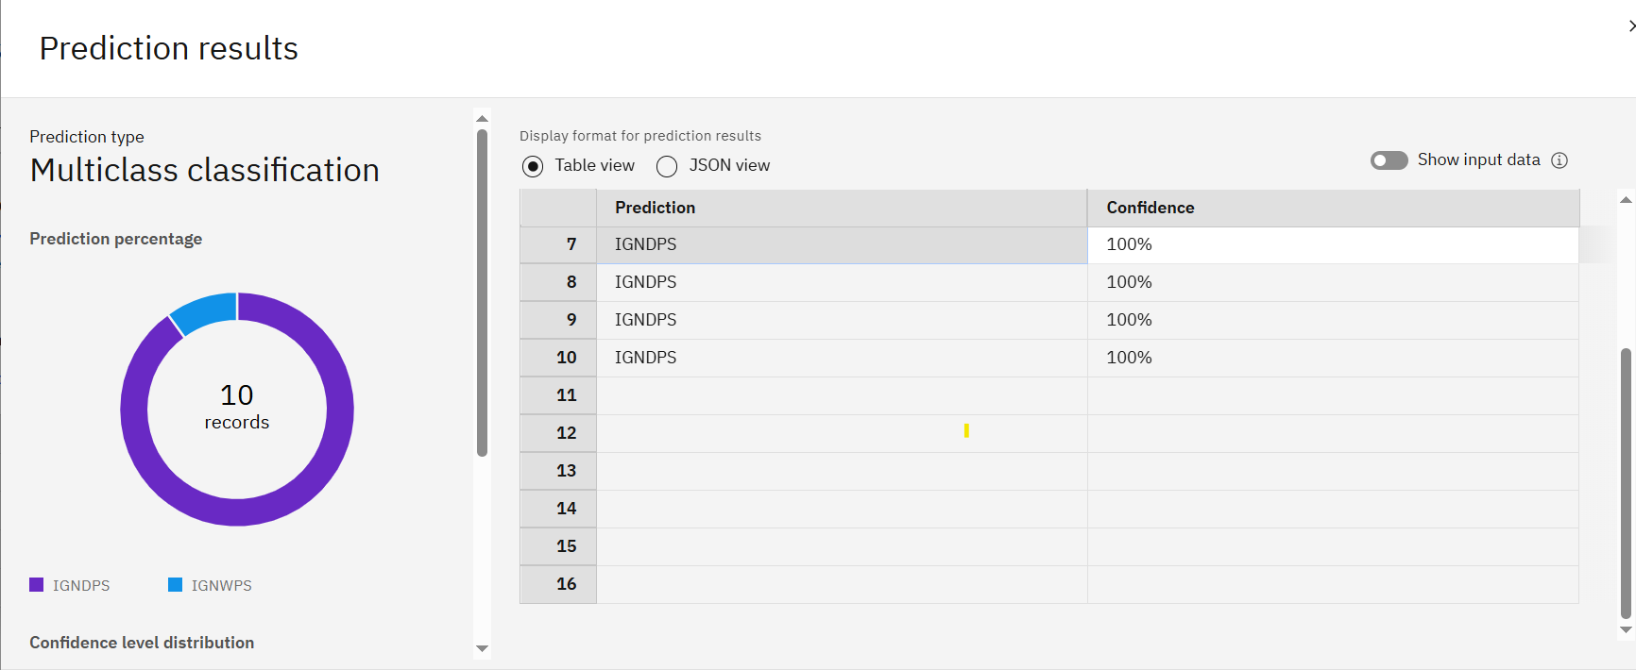
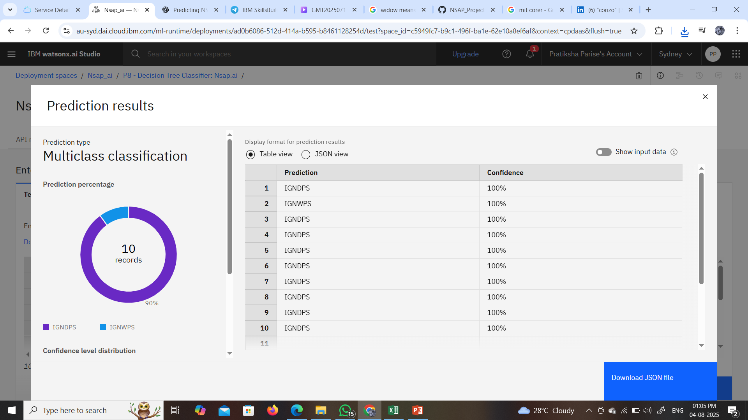
output

Slide 9
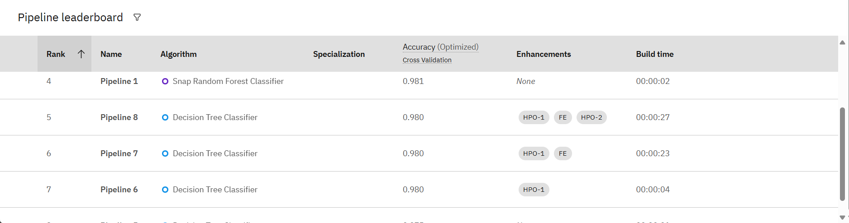
Created pipeline after create model

Slide 10
Conclusion
The successful development of the AI-powered NSAP Eligibility Prediction Model marks a significant step forward in modernizing social welfare delivery. By automating complex eligibility assessments with high accuracy, the model enhances operational efficiency, reduces human error, and accelerates aid distribution. It demonstrates how structured government data, such as that from AI Kosh, can be leveraged to build impactful AI solutions. This project not only ensures timely support to vulnerable populations but also sets the stage for scaling to other welfare programs, reinforcing the role of AI in driving inclusive and data-driven governance.

Slide 11
Future scope
Our NSAP Eligibility Prediction Model lays a strong foundation, with significant potential for future enhancements and broader application to maximize its social impact.
Seamless Integration with Government Portals:
Integrate the model's API directly with existing or new government online application portals.
This enables real-time eligibility checks and automated scheme recommendations at the point of application submission, greatly enhancing user experience and administrative efficiency.
Enhancing Trust with Explainable AI (XAI):
Implement Explainable AI (XAI) techniques to provide clear, human-understandable reasoning behind the model's predictions.
This fosters greater transparency and trust among applicants and administrators, allowing for auditing and verification of decisions.
Multilingual Interface for Broader Accessibility:
Develop a multilingual user interface, potentially leveraging services like IBM Granite for translation capabilities.
This will allow applicants from diverse linguistic backgrounds across India to input data and receive predictions in their preferred regional language, ensuring wider accessibility and inclusion.
Continuous Learning and Model Updates:
Establish a robust feedback loop for continuous model improvement.
Periodically retrain and update the model using new applicant data, verified outcomes, and any revised NSAP scheme criteria, ensuring ongoing accuracy and relevance.
Broader Social Program Applicability:
Extend this successful predictive framework to other government social welfare or subsidy schemes within India (e.g., health, education, housing subsidies).
Leverage similar data-driven approaches to optimize resource distribution across various sectors, contributing to a more comprehensive and efficient digital welfare system.

Slide 12
References
National Social Assistance Programme (NSAP) Dataset:
AI Kosh, IndiaAI: https://aikosh.indiaai.gov.in/web/datasets/details/district_wise_pension_data_under_the_national_social_assistance_programme_nsap_1.html
IBM Cloud & Watsonx.ai Documentation:
https://cloud.ibm.com/projects
Official documentation for IBM Watsonx.ai, particularly sections related to AutoAI and Model Deployment.
General IBM Cloud documentation for platform services and infrastructure.

Slide 13
IBM Certifications
Screenshot/ credly certificate( getting started with AI)

Slide 14
IBM Certifications
Screenshot/ credly certificate( Journey to Cloud)

Slide 15
IBM Certifications
Screenshot/ credly certificate( RAG Lab)

Slide 16
THANK YOU

